Slide 1
EES203: Geochemistry
Instructor: Anoop Ambili
Email id: anoop@iisermohali.ac.in

Slide 2
Geochemical evolution of atmosphere

Slide 3
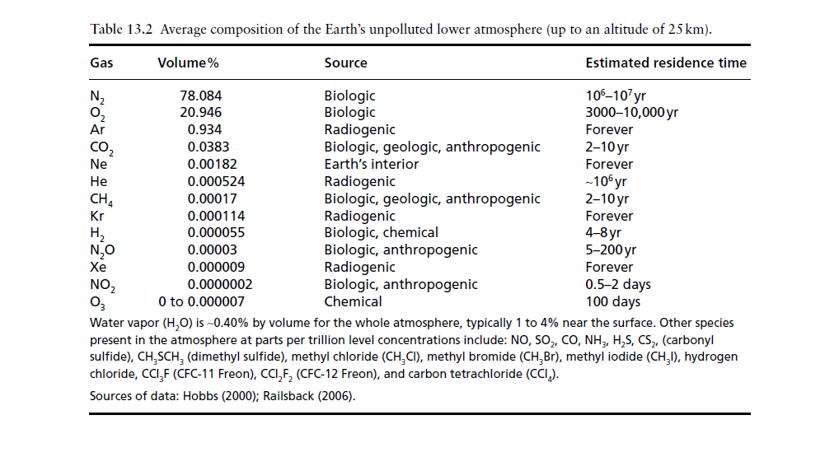
Composition of Earth’s atmosphere
Source: Introduction to Geochemistry (Principles and Applications)
Kula C. Misra (The Crust–Hydrosphere–Atmosphere System)

Slide 4
Composition of Volcanic Gases
Present day….
80% H₂O
10% CO₂
6% SO₂
1% H₂
Major gases are in oxidized form now.
Trace of N₂, HCl
Early atmosphere:
Free O2 would have been absent.
CO₂ and CH₄ were probably abundant.
The CO₂ would have eventually reacted with rocks (in water):
H₂O + CO₂ + “CaSiO₃”➔ CaCO₃ + SiO₂ + H₂O

Slide 5
Urey reaction: H₂O + CO₂ + CaSiO₃ = CaCO₃ + SiO₂ + H₂O
Weathering of feldspar (most abundant mineral group in crust): CaAl₂Si₂O₈ + 3H₂O + 2CO₂ = Al₂Si₂O₅(OH)₄ + Ca²⁺ + 2HCO₃⁻
plagioclase feldspar kaolinite = clay mineral = shale
Precipitation of calcium carbonate (limestone):
Ca²⁺ + 2HCO₃⁻ = CaCO₃ + H₂O + CO₂
calcite or aragonite
Source: Introduction to Geochemistry (Principles and Applications)
Kula C. Misra (The Crust–Hydrosphere–Atmosphere System)

Slide 6
EVOLUTION OF THE OCEAN-ATMOSPHERE SYSTEM: THE RISE OF FREE OXYGEN (O₂)
-- 2 H₂O = 2 H₂ + O₂ Photodissociation
followed by loss of hydrogen to space.
-- CO₂ + H₂O = CH₂O + O₂ Photosynthesis
(Respiration and Decay)
--Free oxygen arose about 2.4 Ga,
and reached near-present levels about 0.8 Ga.
This allowed development of multicellular organisms
and their migration onto land.
Source: Introduction to Geochemistry (Principles and Applications)
Kula C. Misra (The Crust–Hydrosphere–Atmosphere System)

Slide 7
Evidence for the Rise of O₂
Features typical of the Archaean (>2.5 Ga) but rare or absent thereafter:
Banded Iron Formations (“BIF’s”) Absence of redbeds
Detrital uraninite (UO₂) and pyrite (FeS₂)
Paleosols:
mobility of Fe during weathering
Source: Introduction to Geochemistry (Principles and Applications)
Kula C. Misra (The Crust–Hydrosphere–Atmosphere System)

Slide 8
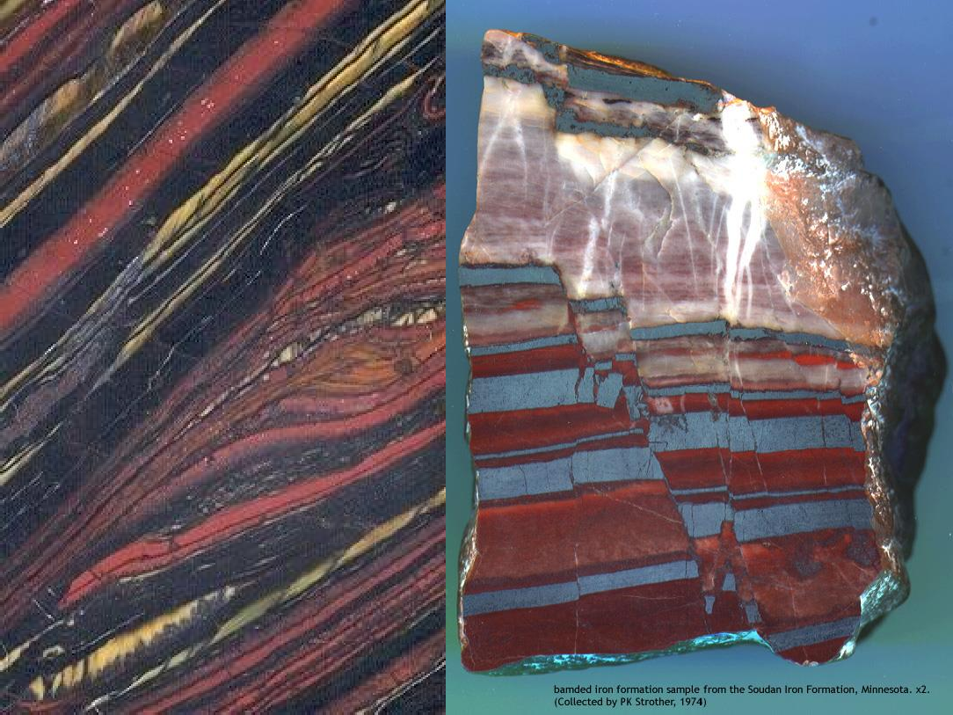
Banded Iron Formations
Banded Iron Formations (“BIF’s”)
Northern Minnesota
Western Australia

Slide 9
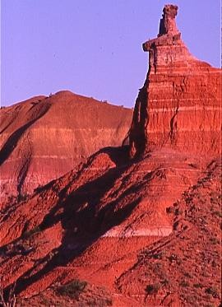
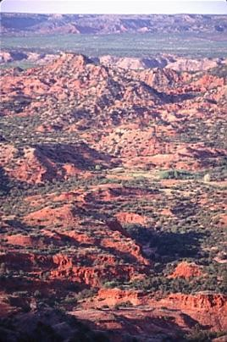
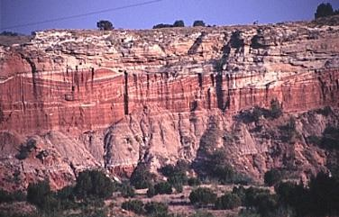
Permian and Triassic redbeds in West Texas

Slide 10
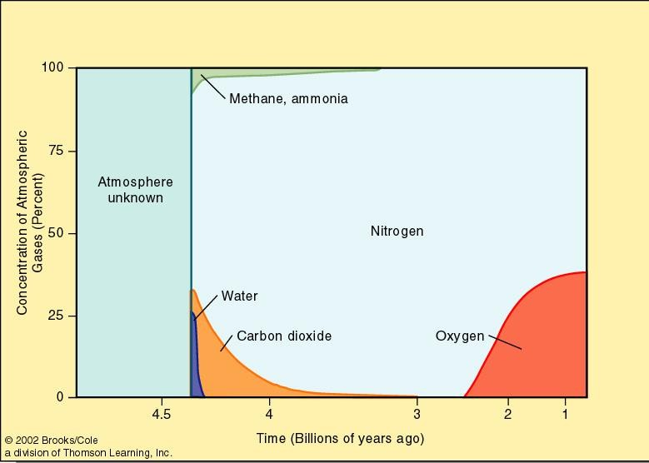
Possible evolution of Earth’s atmosphere over geologic time

Slide 11
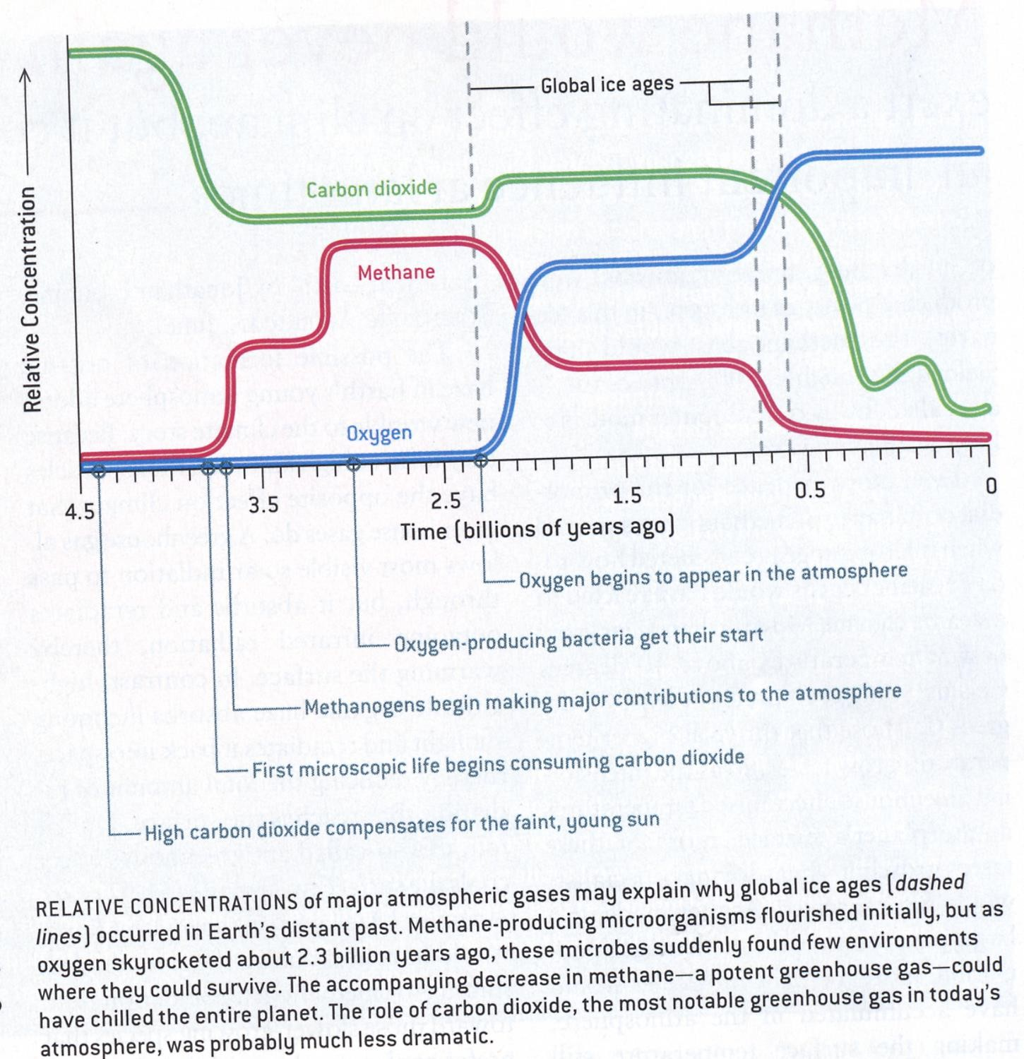

Slide 12
Geochemical evolution of hydrosphere

Slide 13
Hydrosphere is the component of the Earth supersystem that includes the various reservoirs of water and ice on or close to the Earth’s surface.
The global ocean, covering about 71% of Earth’s surface to an average depth of 3800 m (12,5000 ft), is the predominant feature of the hydrosphere.
The oceans contain ∼1370 × 106 km3 of water and account for 97% of Earth’s water; groundwater, rivers, lakes, glaciers and ice caps account for the rest of the hydrosphere.

Slide 14
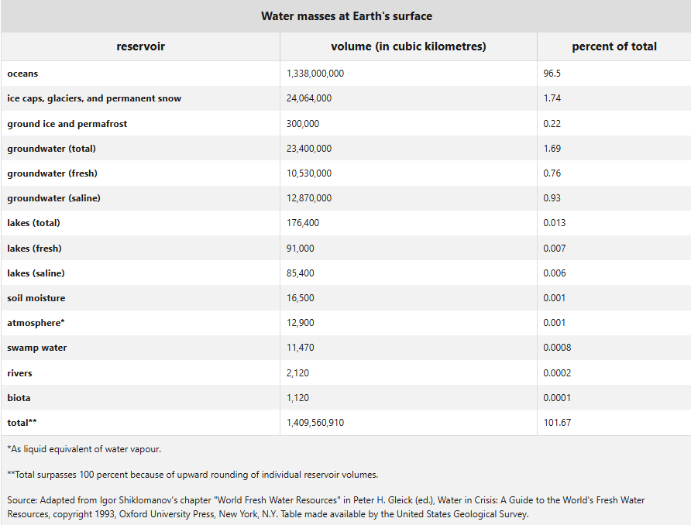
Distribution and quantity of Earth’s waters

Slide 15
Composition of modern seawater
These seven constituents account for more than 99% of the dissolved constituents in both seawater and river water

Slide 16
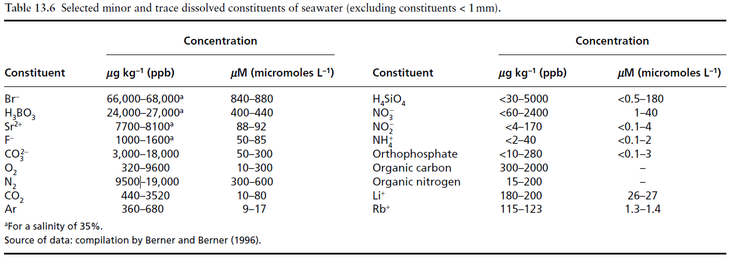
Composition of modern seawater
Concentration ratios of dissolved minor and trace elements relative to chloride do show significant variations from place to place (Table 13.6), especially the constituents such as phosphates and nitrates, which are nutrients for plankton and reflect the metabolic activities of the organisms that are abundant only in the upper few tens or hundreds of meters.

Slide 17
Composition of modern seawater
Dissolved constituents in seawater are of three kinds: conservative, recycled, and scavenged (Walther, 2009).
The concentrations of conservative constituents (such as Br-, Cl-, Mg2+, Na+) relative to other conservative constituents remain constant. This results in a constant concentration versus depth profile for each conservative element, unless its absolute abundance is modified by a change in the volume of seawater. Such constituents usually have long residence times (> 10⁶ years) in the ocean.
Recycled and scavenged constituents are nonconservative and their concentrations vary significantly from place to place.
Recycled constituents refer to those (such as organic C, H₄SiO₄, Ca²⁺, NO₃–, and PO₄^{–3}) that are recycled through the involvement of organisms.
Scavenged constituents (such as Pb, Mn, Sn) are those that are adsorbed onto the surfaces of solid articles

Slide 18
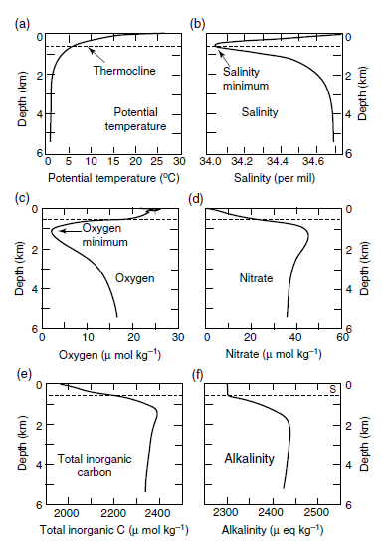
Composition of modern seawater

Slide 19
Factors responsible for modifying seawater chemistry
Processes capable of modifying the chemistry of seawater, besides addition of constituents by rivers, fall into six categories
Biological processes Such processes exert major controls on the concentration of recycled constituents (Ca²⁺ , HCO₃⁻,SO₄²⁻, H₄SiO₄, CO₂, O₂, NO₃⁻, and PO₄³⁻).
(2) Seafloor volcanics–seawater interaction, both high temperature (200–400°C) reactions at mid-oceanic ridge axes and off-axis low temperature reactions.
(3) Reaction of seawater with detrital solids transported from the continents. Such reactions may involve an entire detrital mineral or affect only the mineral surface by ion exchange, especially of Ca²⁺ for Na⁺. Ion exchange is particularly important for trace elements.
(4) Ocean-to-air transfer of cyclic salts: sea-salt particles blown from the ocean surface onto the land).
(5) Precipitation of evaporite and sulfide minerals, an important mechanism for the removal of Na⁺, Ca²⁺, Cl⁻, and SO₄²⁻ from seawater.
(6) Special processes that generally affect only one or two constituents. These include porewater burial of Cl⁻ and Na⁺, and a number of processes unique to the nitrogen and phosphorous cycles (nitrification, denitrification, N2 fixation, adsorption of phosphate on ferric oxides, and authigenic apatite formation).

Slide 20
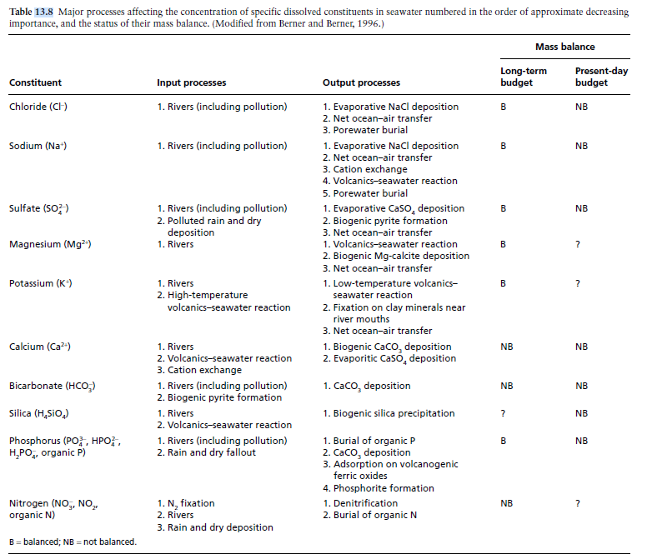
Mass balance of dissolved constituents in seawater

Slide 21
Evolution of the oceans over geologic time
Origin of the oceans
Age of the oceans:
The occurrence of chemical sediments (such as BIFs) in the 3.8-Gyr-old Isua sequence in west Greenland (Nutman et al., 1997; Whitehouse et al., 1999) is indisputable evidence that liquid water was present on the Earth by that time.
A much earlier presence of liquid water on the Earth has been inferred from the 18O-enriched oxygen isotope composition of > 3900-Myr-old magmatic zircon crystals recovered from the Jack Hills metasedimentary belt of Western Australia (Mojzsis et al., 2001; Peck et al., 2001; Cavosie et al., 2005)

Slide 22
Evolution of the oceans over geologic time
Source of waters
Sources of water in the terrestrial planets include:
Comets;
Hydrous asteroids
Phyllosilicates migrating from the asteroid belt
Accreting “wet” planetesimals. : Adsorption of H₂O onto Dust Grains

